Slide 1
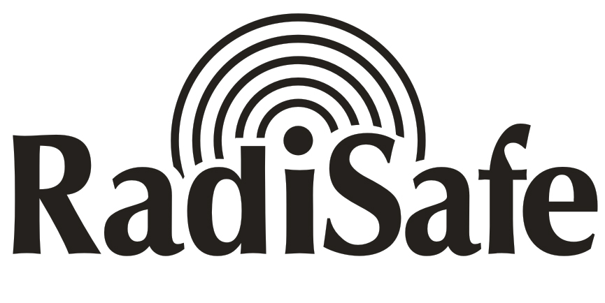
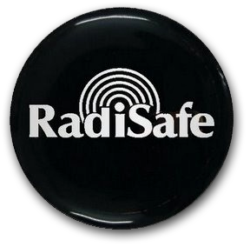
Mobile Phone Radiation Harmonizer

Slide 2
Use RADISAFE and PROTECT your
Ears , Brain and Body against harmful effects of Mobile Phone Radiation and Heating, as more than a million people are doing now with Radisafe.

Slide 4
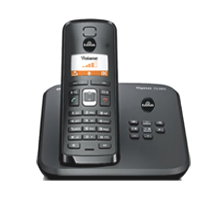

Slide 5
Dangers of Mobile Phone Radiation are proved to the World by many eminent Researchers and NGO s conclusively.

Slide 6
The side effects of continued
Mobile Phone use
by long term users of Mobile Phones are quite
revealing around the world.

Slide 7
The Book ‘Cell Phones – Invisible Hazards in the Wireless Age’ by Dr.George Carlo and Martin Schram published from New Your clearly establishes the relationship between Cancer and Mobile Phone use.

Slide 8
Enough evidence is already made available by eminent researchers around the world, highlighting the Harmful effects of long term use of Mobile Phone.

Slide 9
Head ache, Sleeplessness, Fatigue, burning / piercing sensation in ears, mood swings, degenerative
diseases etc., are common symptoms experienced by active
Mobile phone users.

Slide 10
Talking for longer durations on Mobile Phone Heats up the Brain Tissues and affects the
CELLS around ears and brain.

Slide 11
Many Mobile Phone users now have reported reduced hearing abilities and discomfort in ear region, pushing themselves to develop allergy to
Mobile phone use.

Slide 12
Children with tender skull are exposed to the dangers of Mobile Phone Radiation
much more than men.

Slide 13
Therefore its time we started protecting ourselves against this time ticking Dynamite.

Slide 14
Is it possible to stop talking
on Mobile Phones , which could be the best solution to
PROTECT OURSELVES?

Slide 15
Impossible to think of this option as Mobile Phone is now a part and parcel of our
life and living.

Slide 16
Don’t Worry !
You possibly have a proven and permanent solution now!

Slide 17
STICK RADISAFE TO YOUR MOBILE PHONE NOW AND TALK SAFELY FOR HOURS TOGETHER IF NEED BE,

Slide 18
BUT WITHOUT THE ASSOCIATED DANGERS OF MOBILE PHONE RADIATION AND HEATING.

Slide 19
Thermographic image of the Face and Head with no exposure to harmful mobile phone radiation.
Thermographic image of the Face and Head after 20 minutes of mobile phone call.

Slide 20
Radisafe is a boon to children who talk for more hours on Mobile phone as their tender skull gets protection,
thanks to Radisafe.

Slide 21
The Biological Beneficial Effects of using RADISAFE are clearly proven CLINICALLY.

Slide 22
RADISAFE
TEST REPORTS
&
CERTIFICATIONS

Slide 23
Radisafe is one of the most Lab tested & Certified products of its kind in the World, having been Certified by many accredited laboratories of the World.

Slide 24
California Institute of Electronics and Materials Science, (CIEMS), USA has Certified Radisafe to possess upto 99.92%
of Electro Magnetic Shielding Effectiveness tested at 9.375 GHz.

Slide 25
Aparajit Instruments , an ISO 9002:2000 Certified Equipment Testing Company, has tested and certified Radisafe to posses upto 80% Heat Reduction ability of Radisafe, when stuck on Mobile Phone.

Slide 26
CENTRE FOR BIOFIELD
SCIENCES, an International Testing Centre for Bio Field Energies, headed by
Dr.Thornton Streeter , D.Sc has Certified the effectiveness of Radisafe through a series of Tests.

Slide 27
49 organ Clinical Study carried out using the World renowned Kirlian GDV Camera has clearly proved the effectiveness of Radisafe while unambiguously exposing the hazards of using unprotected Mobile Phone.

Slide 28
A Research paper ‘Anatomical and Physiological Hazards induced by Mobile Phone Radiation and its prevention by RADISAFE’ Published by Dr.P.Jagadeesh & Dr.P.Saraswathi Saveetha Medical College. Chennai, INDIA

Slide 29
Clinically establishes the changes in Blood Pressure and Pulse Rate levels after using an unprotected Mobile Phone and Radisafe stuck Mobile Phone. Radisafe clearly emerges the WINNER.

Slide 30
Scores of Researchers around the World are using
AURA ENERGY SCANNER
to demonstrate the positive effects of Radisafe on Human Aura energy levels, using the DNA sample of the Mobile user.

Slide 31
Radisafe is
CE Certified.
( European Compliant)

Slide 32
Many users around the world have reported many other benefits like extended battery life, better tonal quality and signal strength, enhanced energy levels after Radisafe is stuck onto their Mobile phone.

Slide 33
No wonder Radisafe is the largest selling product of its kind in the World and is currently used in more than 40 Countries of the World.

Slide 34
Corporates around the World are choosing Radisafe as the best Health Gift
they can ever make!

Slide 35
Many IT companies around the World consider Radisafe as the Best Staff Welfare Gadget and GIFT Radisafe to protect their Human Resources and enhance Productivity.

Slide 36
Radisafe can also be used on other Radiation emitting gadgets such as TV, Computers,
Laptops, Refrigerators,
Microwave ovens,
Air conditioners etc.,

Slide 37
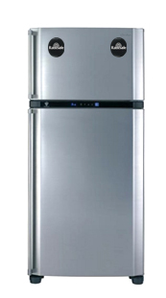

Slide 38
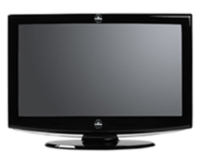

Slide 39
RADISAFE
TECHNOLOGY

Slide 40
Radisafe uses an Unique Proprietary and Patented Technology –
Mineral + Scalar Technology and its effects can never be copied or reproduced by anybody.

Slide 41
RADISAFE TECHNOLOGY IS AWAITING PATENT VIDE PATENT REGN NO: 6722/RQ/CHE/2012.

Slide 42
The Mineral Combination as a result of more than 3 years Research, packed into Radisafe helps to immediately Harmonize Radiation and consequent heating of Mobile Phone.

Slide 43
Scalar Energy Embedding
on Radisafe permanently helps to keep the body at the most beneficial frequency, when one touches the Mobile phone.

Slide 44
IT CAN’T BE
BETTER
THAN THIS
EVER!

Slide 45
ACT NOW !
USE RADISAFE and PROTECT
your Ears and Brain,
rather than regret later,
when the damage is done.

Slide 46
STICK RADISAFE NOW
&
ENJOY HOURS OF
HARMLESS AND
HAZARDLESS
TALKING ON
MOBILE PHONE.

Slide 47
RADIATION TEST

Slide 48
Radiation cannot be felt directly by human beings or else Mobile Phone users would have protected themselves by now!

Slide 49
No Meter has been designed so far to detect the difference between Radiation and Harmonized Radiation.

Slide 50
Similarly the effects of shielding of
Harmful Radiation also
cannot be felt directly, but only by its beneficial and welcome Biological effects.

Slide 51
Radisafe with its Unique Technology Harmonizes Mobile Radiation and
Protects the users at
Biological levels
which is the real testimony
of the product.

Slide 52
The clinical studies done by various Laboratories conclusively confirm the effectiveness of Radisafe at Biological levels.

Slide 53
Then why delay ?
Join the band of more than a
million of users of Radisafe
around the World & Protect yourself & your children for life time!

Slide 54
Mobile Phone Radiation Harmonizer

